Slide 1
Fridgify
Smart Recipe Recommender
A Personalized Recipe Solution to Reduce Food Waste and Simplify Meal Planning
JK Team
Jingbo Wang, ChengKai Yang

Slide 2
Project Description
Application Objective.
Help users make the best use of available ingredients and reduce food waste
Provide personalized recipe recommendations to simplify meal planning
Target Users.
Busy individuals: want to quickly find recipes based on available ingredients
Culinary enthusiasts who want to explore new recipes without having to shop too much
People with dietary restrictions: need to filter recipes based on dietary preferences

Slide 3
Core Functions
Ingredient input: Users input the ingredients in the refrigerator.
Personalized Recommendations: Support personalized recommendations for taste, dietary preferences and health needs.
Offline Cache: Browsed recipes and user data are cached locally and can be viewed even when offline.
Step-by-step cooking instructions: Each recipe provides detailed steps and instructions.
Push notifications: New recipe recommendations or seasonal ingredient alerts (optional)
Usage Analytics: Track user preferences and optimize recommendations with Firebase Analytics (optional).

Slide 4
Technical Architecture
Frontend: Building Dynamic UI (Recommendation Interface, Recipe Details, Ingredient Input) with Jetpack Compose
Backend: Firebase Authentication
Firebase Authentication: user login and authentication
Room database: offline storage of user preferences, ingredients, and cached recipes
Spoonacular API: access to recipe data, with support for ingredient matching
Firebase Analytics: Records and analyzes user behavior.
Push Notifications: Firebase Cloud Messaging notifies users of newly recommended recipes.

Slide 5
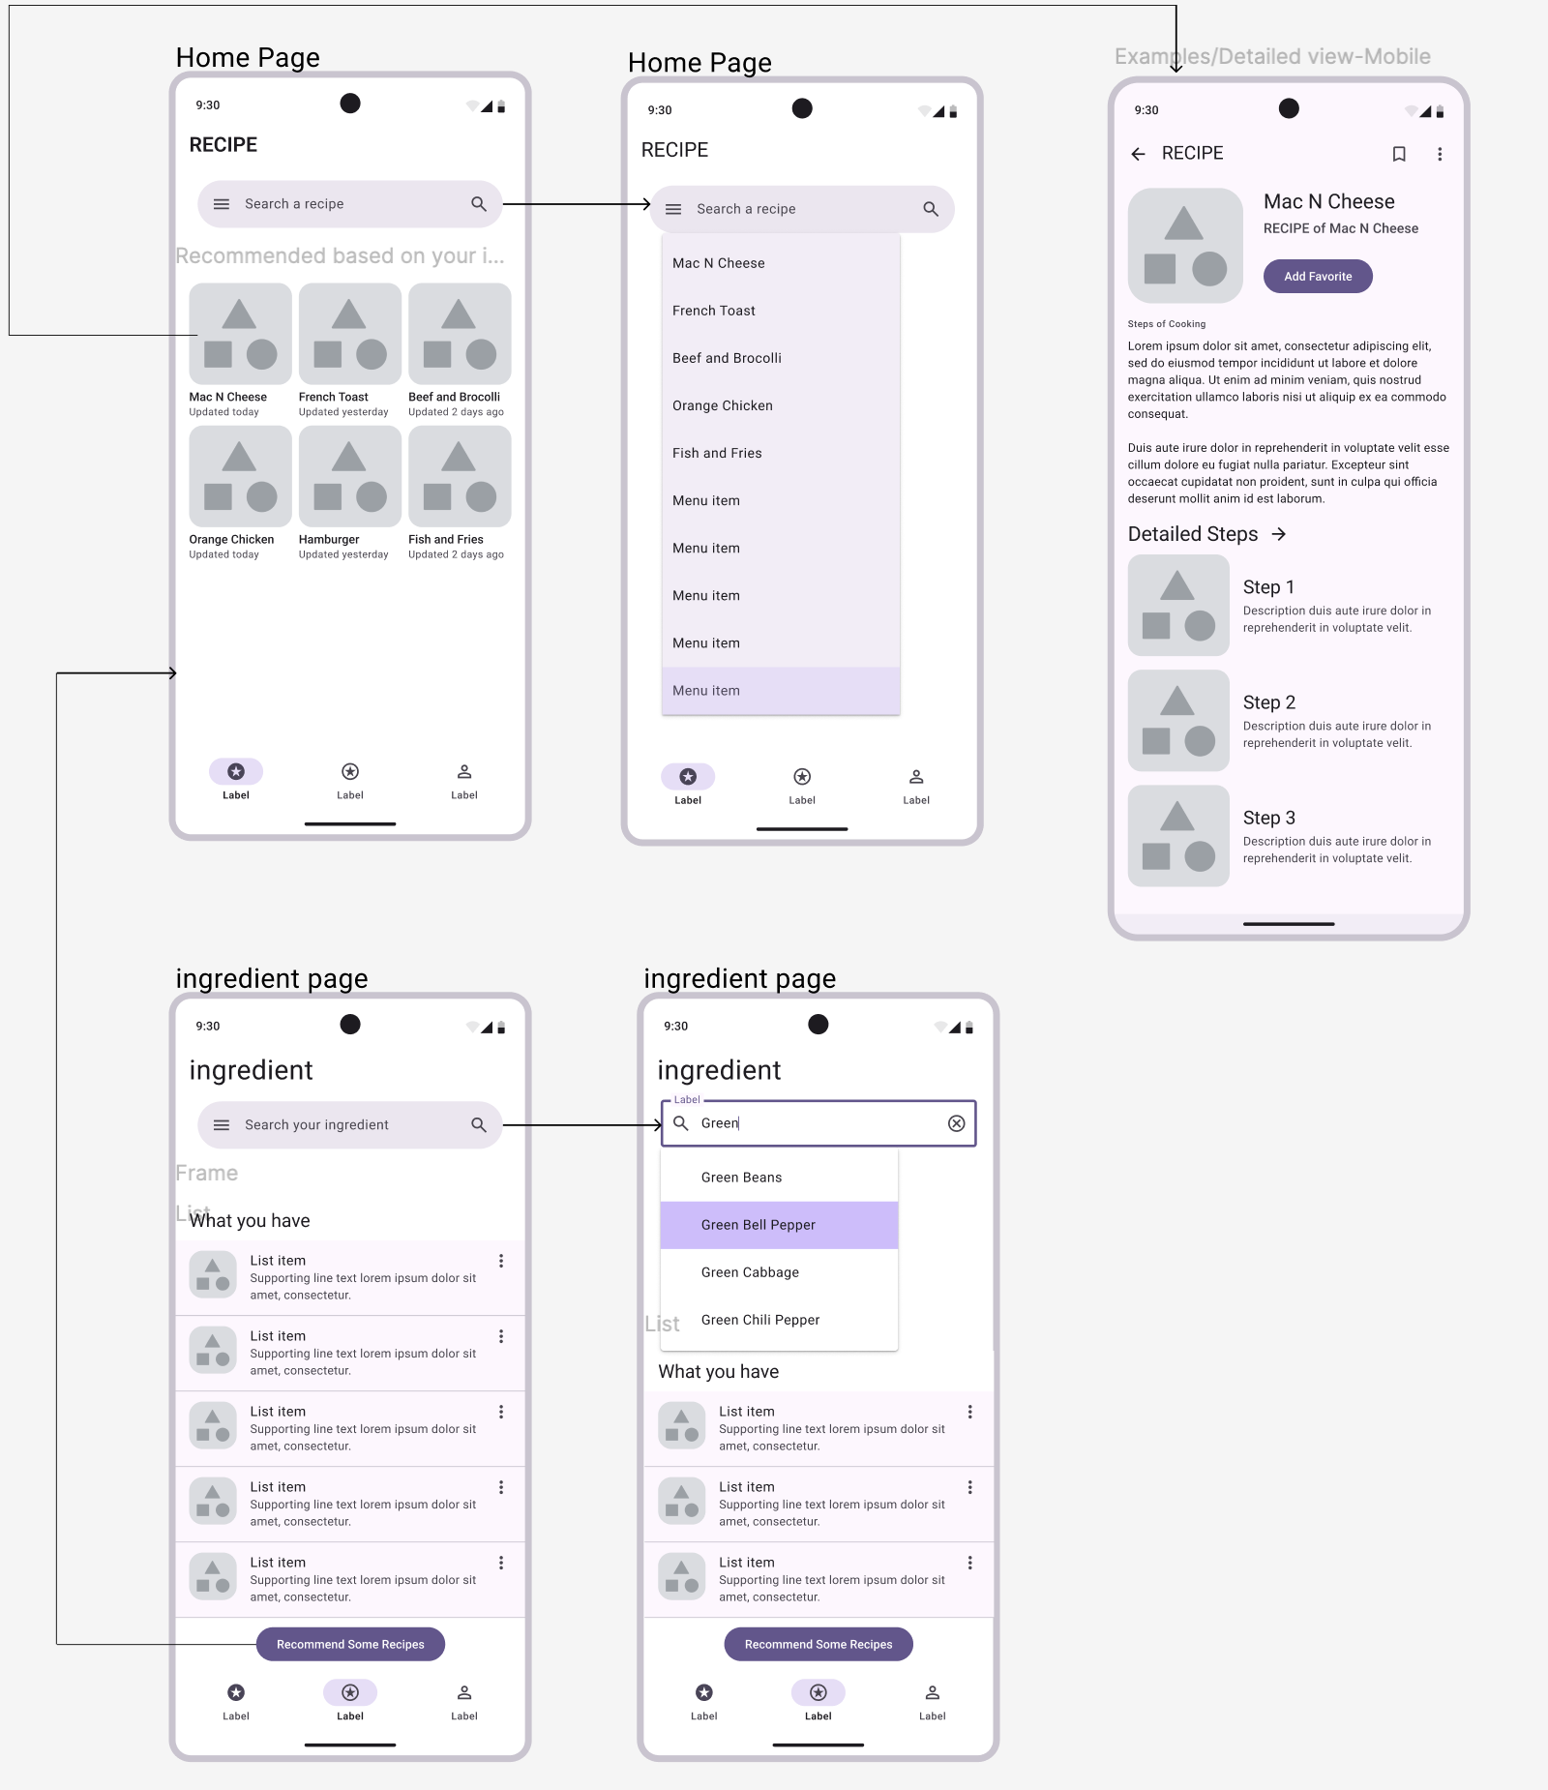
Preliminary UI Design
Ingredient input screen: user inputs existing ingredients
Recommendation page: shows recommended recipes based on ingredients
Recipe details page: detailed cooking steps and nutritional information.
Preferences: Allows user to set dietary preferences, taboos, etc.

Slide 6
Offline functionality and data caching
Offline Mode.
Uses the Room database to cache the recipes viewed and the ingredients entered by the user.
While offline, users can still browse recent recommendations and recipes.
Data synchronization.
Automatically synchronizes with WorkManager to keep data up-to-date when the network is restored.
Multi-device data synchronization using Firebase Firestore (optional)

Slide 7
Expanded Functionality (optional)
Future Expansions: Meal Planner & Shopping List
Meal planning and shopping lists: Generate weekly meal plans and automatically generate shopping lists.
Voice Command Support: Use your voice to search and navigate during the cooking process.
Ingredient expiration reminders: Track ingredient expiration dates to minimize food waste.
Integration with Health app: Synchronize nutritional information to the Health app to help users manage calories and nutritional intake.

Slide 8
Costs and Alternatives to Using the Spoonacular API
Spoonacular API.
The free version provides 150 requests per day, but has limited functionality.
Paid version provides richer data and higher request limits
Alternatives.
Edamam API, TheMealDB, Recipe Puppy, etc. There are also different free and paid options.

Slide 9
Project Objectives and Conclusions
Project Objective.
Build an intuitive and feature-rich smart recipe recommendation app
Provide a personalized cooking experience to help users reduce food waste
Summary.
Smart Recipe Recommender will help users find the right recipes based on available ingredients, improving cooking efficiency and enjoyment.
More features can be added in the future to make the app even smarter and more comprehensive.

Slide 10
Thank You!

